Slide 1
MULTIPLES OF 5 THAT TOTAL 100
BY
SUSHIL VARMA

Slide 2

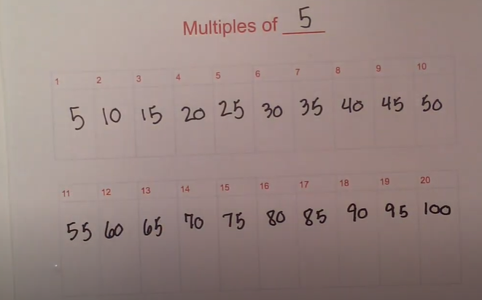
Multiples of 5 : 5, 10, 15, 20, 25, 30, 35, 40, 45, 50
55, 60, 65, 70, 75, 80, 85, 90, 95,100 etc

Slide 3
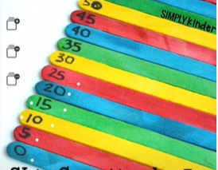
Multiple of 5 always that ends with
0 or 5 in the units

Slide 4
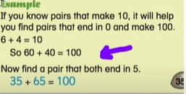
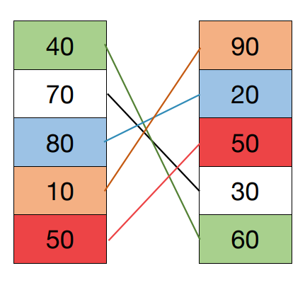
Pairs of multiples of 5 that total 100

Slide 5

Q & A

Slide 6
Thank You.

